Slide 1
Working With XML Schemas

Slide 2
Schemas
A schema is an XML document that defines the content and structure of one or more XML documents.
The XML document containing the content is called the instance document.

Slide 3
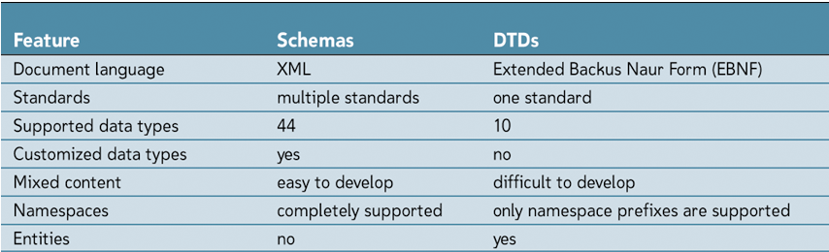
Schemas versus DTDs

Slide 4
Schema Vocabularies
Several schema “vocabularies” have been developed in the XML language
Support for a particular schema depends on the XML parser being used for validation.
XML Schema (XSD) most widely used
W3C Standard

Slide 5
Creating Schema Files
Must be placed in a separate XML document that is referenced by the instance document
Root element of schema document is the schema element
Types of elements
Complex type has one or more attributes, or is the parent to one or more child elements.
Simple type element contains only character data and has no attributes.
Notes:
Show patients.xml and examine it. Class exercise on complex vs. simple types

Slide 6
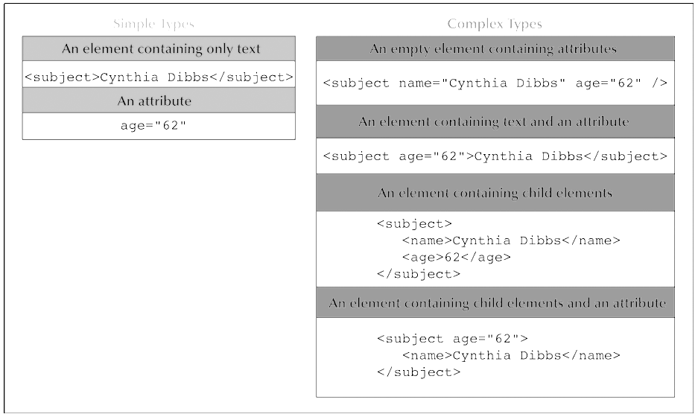
Schema Types
Notes:
Stop and show patients.xml and tell them to look through and find items, type and what

Slide 7
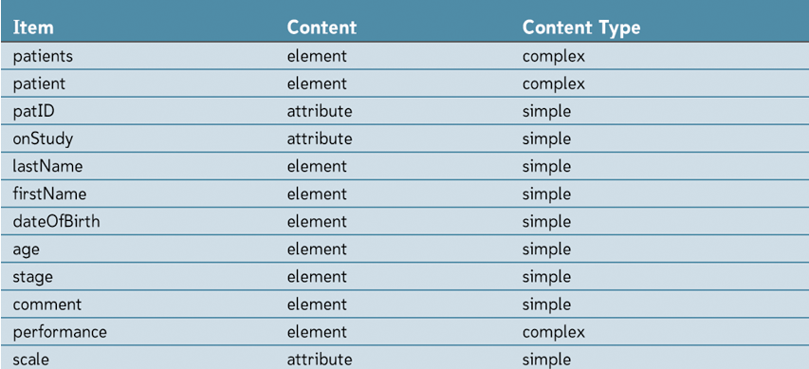
Patient File Elements/Attributes
Notes:
Open up pschema1.xsd and talk about the file

Slide 8
Declaring Simple Type Elements
Syntax:
<element name=“name” type =“type”/>
name is the name of the element in the instance document ;
type is the data type of the element.
If a namespace prefix is used with the XML Schema namespace, any XML Schema tags must be qualified with the namespace prefix
Example
<lastName>Dibbs</lastName>
<xs:element name="lastName" type="xs:string" />

Slide 9
Data Types
Built-in data type
Part of the XML Schema specifications
Available to all XML Schema authors
User-derived data type
Created by the XML Schema author
Specific data values in the instance document
Notes:
Show pschema2.xsd

Slide 10
Declaring an Attribute
An attribute is just another simple type.
The syntax is
<xs:attribute name="name" type="type" default="default" fixed="fixed" />
name is the name of the attribute
type is the data type
default is the attribute’s default value
fixed is a fixed value for the attribute
Notes:
Show pschema3.xsd

Slide 11
Associating Elements & Attributes
Elements with attributes become complexType elements
Basic structure for defining a complex type element is
<xs:element name="name">
<xs:complexType>
declarations
</xs:complexType>
</xs:element>
name is the name of the element
declarations is schema commands specific to the type of complex element being defined
Notes:
Attributes need to be associated with elements.

Slide 12
Complex Type Elements
Empty element and contains only attributes
Element contains textual content and attributes but no child elements
Element contains child elements but not attributes
Element contains both child elements and attributes

Slide 13
Empty Elements with Attributes
Declaration
<xs:element name="name">
<xs:complexType>
attributes
</xs:complexType>
</xs:element>
attributes is the set of declarations that define the attributes associated with the element
Notes:
Example – Look at patient element for
<patient patID="MR890-041-02" onStudy="TBC-080-5" /> and the declaration in pschema4.xsd

Slide 14
Simple Content & Attributes
If an element is not empty and contains textual content (but no child elements), the structure of the complex type element is slightly different
<xs:element name="name">
<xs:complexType>
<xs:simpleContent>
<xs:extension base="type">
attributes
</xs:extension>
</xs:simpleContent>
</xs:complexType>
</xs:element>
Notes:
Show example of performance being defined for: <performance scale="Karnofsky">0.81</performance> in pschema5.xsd

Slide 15
Use of an Attribute
An attribute may or may not be required with a particular element
Add the use attribute to the element declaration or reference
Use can be
required—The attribute must always appear with the element
optional—The use of the attribute is optional with the element
prohibited—The attribute cannot be used with the element
Notes:
Previous example introduced the use attribute

Slide 16
Child Elements
Complex type element can contain child elements, but no attributes
<xs:element name="name">
<xs:complexType>
<xs:compositor>
elements
</xs:compositor>
</xs:complexType>
</xs:element>
elements is the list of simple type element declarations for each child element
compositor defines how the child elements are organized.

Slide 17
Using Compositors
XML Schema supports the following compositors:
sequence defines a specific order for the child elements
choice allows any one of the child elements to appear in the instance document
all allows any of the child elements to appear in any order in the instance document; however, they must appear either only once or not all.

Slide 18
Named Types
Can create customized complex types
Complex structure can be reused in the document
<xs:element name="client">
<xs:complexType>
<xs:sequence>
<xs:element name="fName" type="xs:string"/>
<xs:element name="lName" type="xs:string" />
</xs:sequence>
</xs:complexType>
</xs:element>
Notes:
Code declares an element named client containing the complex content of two child elements named fName and lName:
Show compositors.xsd and talk about two examples
Show pschema6.xsd – point out patients having patient elements (at least one)
Point out patient having sequence AND attributes. Note that I’ve removed the definition of the simple types

Slide 19
Mixed Content
Element can contain both text and child elements
Set mixed attribute is set to “true”
Child elements can then be defined with the conventional method
<Summary>
Patient <Name>Cynthia Davis</Name> was enrolled in
the <Study>Tamoxifen Study</Study> on 8/15/2003.
</Summary>
<xs:element name="Summary">
<xs:complexType mixed="true">
<xs:sequence>
<xs:element name="Name" type="xs:string"/>
<xs:element name="Study" type="xs:string"/>
</xs:sequence>
</xs:complexType>
</xs:element>

Slide 20
Referencing Elements & Attributes
Rather than nesting the attribute declaration within the element, create a reference to it
<xs:element ref="elemName" />
<xs:attribute ref="attName" />
elemName is the name used in an element declaration
attName is the name used in an attribute declaration
Notes:
Look at pschema7.xsd and see what was done with the names

Slide 21
Applying a Schema
Instance document – document which is an example of a defined schema (like class/object)
Attach a schema to the document:
Declare a namespace for XML Schema in the instance document
Indicate the location of the schema file
Declare the XML Schema namespace in the instance document add attribute to the document’s root element:
xmlns:xsi="http://www.w3.org/2001/XMLSchema-instance"

Slide 22
Applying a Schema
Need to specify the location of the schema file
No namespace for contents of the instance document (local xsd), add the following attribute to the root element:
xsi:noNamespaceSchemaLocation="schema"
Existing namespace
xsi:SchemaLocation= "URI" "schema"
Notes:
Show patients.xml for local copy and patients2.xml for online copy

Slide 23
Data Types
A primitive data type, also called a base type, is one of 19 fundamental data types not defined in terms of other types.
A derived data type is a collection of 25 data types that the XML Schema developers created based on the 19 primitive types.

Slide 24
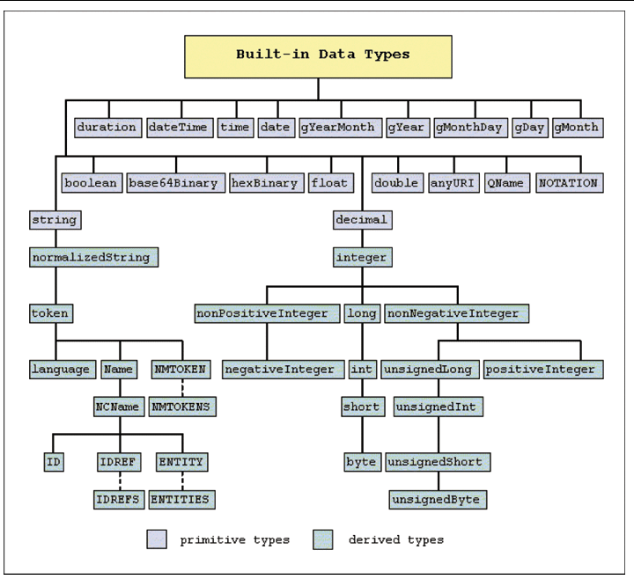

Slide 25
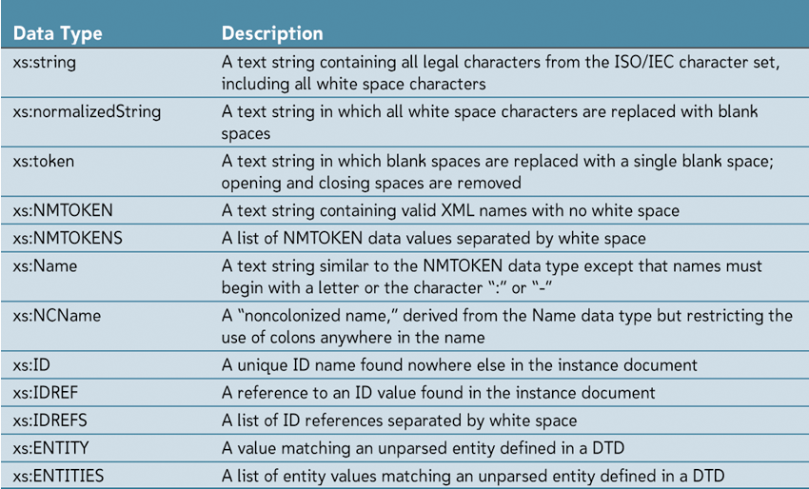
Understanding Data Types
Notes:
These are some of the string ones. There are also number ones and date ones. They are in your text and, of course, on the Internet

Slide 26
Deriving New Data Types
Three components are involved in deriving new data types:
Value space: the set of values that correspond to the data type
Lexical space: the set of textual representations of the value space
Facets: the properties of the data type that distinguish one data type from another

Slide 27
User Derived Data
New data types fall into three categories:
List: a list of values where each list is derived from a base type
Union: the combination of two or more data types
Restriction: a limit placed on the facet of a base type

Slide 28
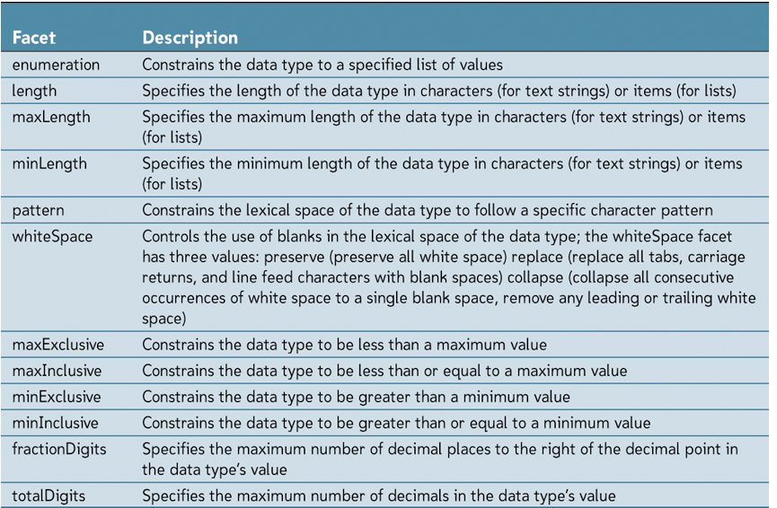
Restricted Data Type
Restrict the properties of a base type
XML Schema provides twelve constraining facets for this purpose.
Notes:
Show ageType, scaleType and stageType in pschema.xsd for minInclusive and enumeration
Show minExclusive and maxExclusive for perfType

Slide 29
The Patterns Facet
Created a pattern with a formatted text string with a regular expression
Syntax
<xs:simpleType name="name">
<xs:restriction base="type">
<xs:pattern value="regex"/>
</xs:restriction>
</xs:simpleType>
regex is a regular expression pattern
Notes:
Show mrType and studyType. Compare with values in patients.xml

Slide 30
Named Model Groups
A collection, or group, of elements
<xs:group name="name">
elements
</xs:group>
name is the name of the model group
elements is a collection of element declarations
Same for attribute groups
<xs:attributeGroup name="name">
attributes
</xs:attributeGroup>
Notes:
How patvb.xsd and look at group childElements and patientAtt and declaration for pType

Slide 31
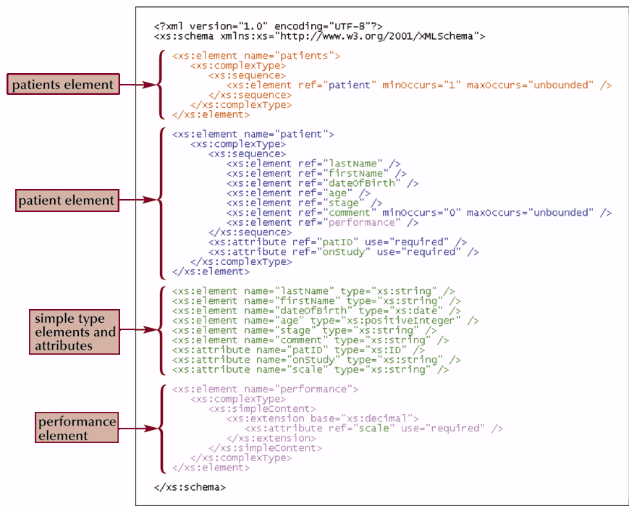
Structuring a Schema – Flat Catalog
All element declarations are made globally.
Notes:
What we did with pschema.xsd

Slide 32
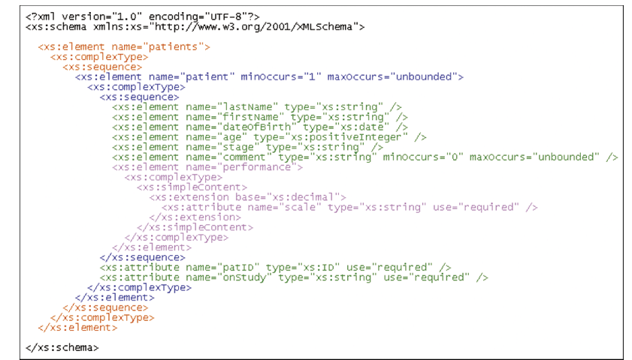
Structuring a Schema – Russian Dolls
Design involves sets of nested declarations
Easy to associate schema with instance document
Can be confusing and difficult to maintain.

Slide 33
Structuring a Schema – Venetian Blinds
Similar to a flat catalog
Instead of declaring elements and attributes globally, create named types and references those types within a single global element
Only globally declared element is the root element;
All other elements and attributes are placed within element or attribute groups or within a named complex type

Slide 34
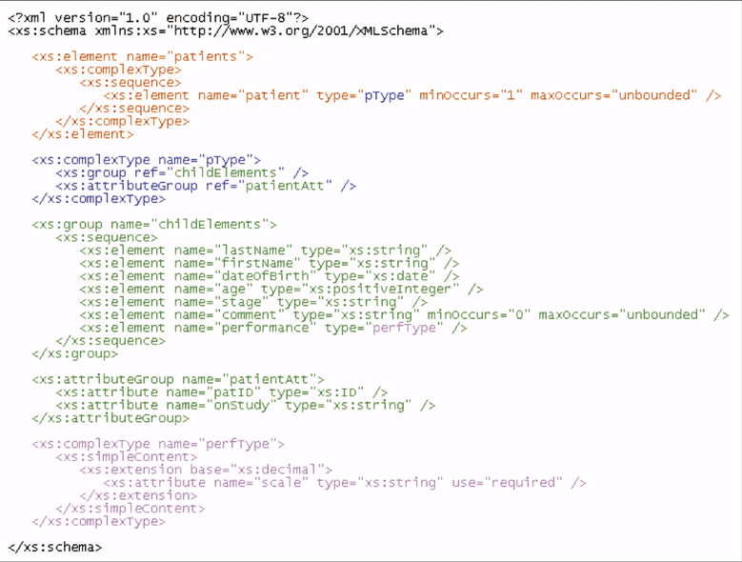
Venetian Blind Design
Notes:
Show patvb.xsd

Slide 35
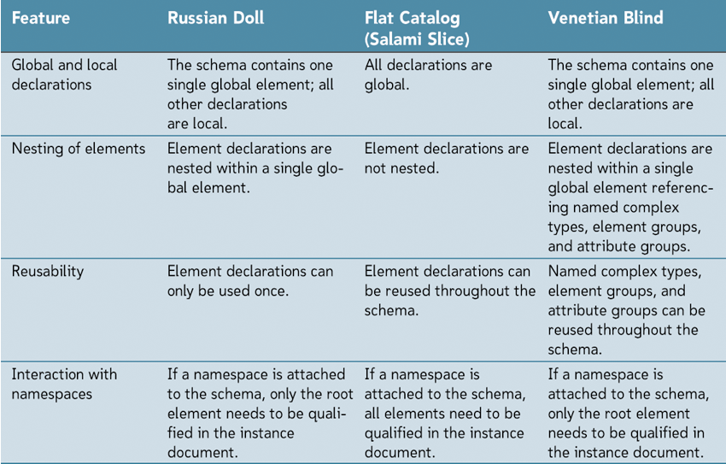
Comparing Schema Designs

Slide 36
Schemas in Namespaces
Associate a schema with a namespace, you first declare the namespace and then make that namespace the target of the schema. To do this, you add the following attributes to the schema’s root element:
prefix:xmlns="uri"
targetNamespace="uri"
prefix is the prefix of the XML Schema namespace
uri is the URI of the target namespace
Notes:
Show patvb.xsd

Slide 37
Including & Importing Schemas
To include a schema from the same namespace, add the following element as a child of the schema element:
<xs:include schemaLocation="schema" />
schema is the name and location of the schema file
To import a schema from a different namespace, use the syntax
<xs:import namespace="uri" schemaLocation="schema" />
uri is the URI of the imported schema’s namespace

Slide 38
Objects in Other Schemas
Once a schema is imported, any objects it contains with global scope can be referenced
To reference an object from an imported schema, you must declare the namespace of the imported schema in the schema element
You can then reference the object using the ref attribute or the type attribute for customized simple and complex types

